Slide 1
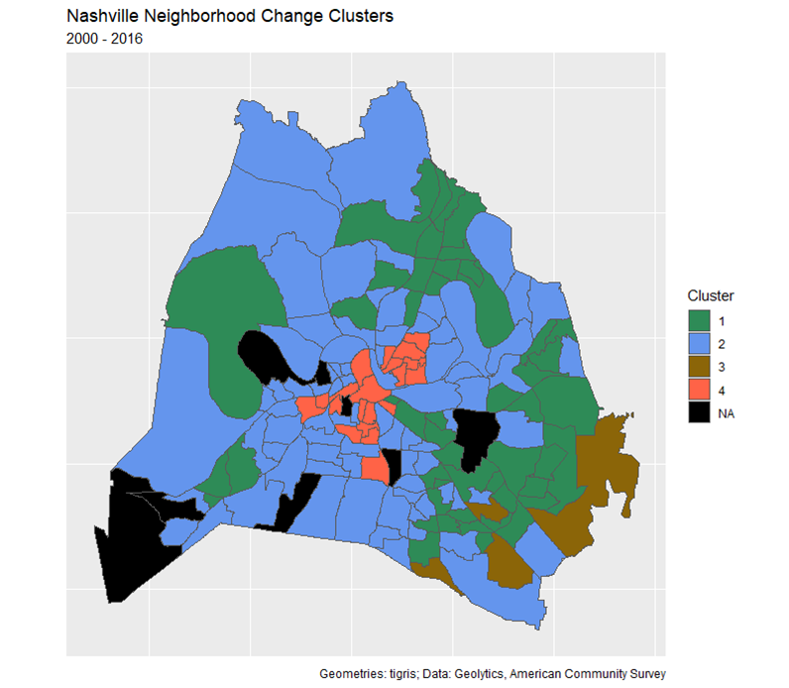
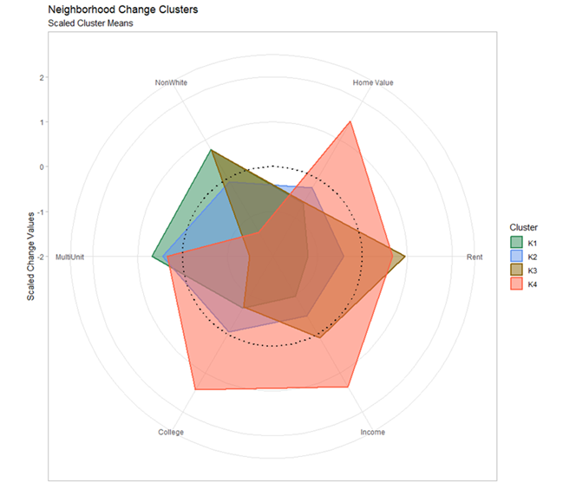
Unsupervised Machine Learning to Identify Gentrification in Nashville, TN.
%Δ Non-White
%Δ Home Value
K1
K2
K3
K4
NA
East Nashville
Germantown
%Δ Multi-Unit
%Δ Rent Value
Nations
The Gulch
12 South
%Δ College Degrees
%Δ Income

